Slide 1

UAV Anomaly Detection
Group No : 8
Vivekanand Education Society's Institute Of Technology
Address: Hashu Adwani Memorial Complex, Collector's Colony, Chembur, Mumbai, Maharashtra 400074
Department of Artificial Intelligence and Data Science
Guide : Mrs. Sangeeta Oswal
Co-Guide : Mrs. Samruddhi Y
59, Mrunal Shinde
63, Rashmit Vartak
67, Chaitali Gaikwad
68, Kapil Bodas

Slide 2
Agenda
Introduction
Problem Statement
Methodology
Proposed Solution
Explainable AI (XAI)
Model Results
Conclusion
Facts
According to the Global State of Drones 2024 report by Drone Industry Insights (DII), India ranks second among the top 10 countries shaping the commercial drone industry, only after the United States.
NETRA is used by DRDO for the mass surveillance Internet traffic analysis system by DRDO.

Slide 3
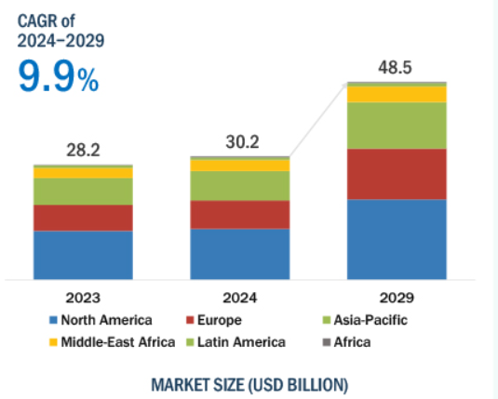
Market place
The UAV market is forecasted to grow by USD $20.40 billion during 2023-2029.
The India Drone Market is expected to grow from $654 million in 2024 to $1.4 billion by 2029.
India tops the list of drone importing nations with 22.5% of global imports.
Notes:
CAGR (Compound Annual Growth Rate) measures the average annual growth rate of a market
Netra
A compact and portable UAV used by the Indian Army for surveillance and reconnaissance missions. It has a range of 2 km and an altitude of 200 meters.
India tops the list of drone importing nations with

Slide 4
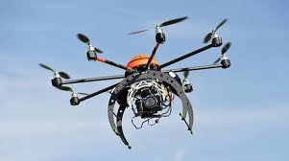
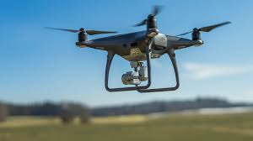
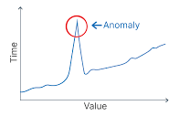
Introduction
These are Unmanned Aerial vehicles , an aircraft that can fly without a human pilot onboard.
They are also called as Drones, there also exist range of UAV from small quadcopters to large fixed-wing aircraft.
UAVs can be fully or partially autonomous, but are more often controlled remotely by a human pilot.
Anomaly Detection
Anomaly detection refers to the presence of anomalous data points in acquired data streams. The anomaly detection helps in improving the quality of knowledge patterns.

Slide 5
Problem Statement
Accurate UAV anomaly detection from onboard sensor data is hindered by imbalanced data and inconsistent fault descriptions.
The multidimensional nature of UAV sensor data (e.g., roll, pitch, yaw, errors) complicates feature extraction and anomaly detection, challenging current methods in accuracy and efficiency.
Traditional models lack scalability and fail to capture inter-sensor correlations, while deep learning "blackboxes" lack interpretability, raising trust issues in critical operations.
A robust, scalable, and explainable anomaly detection framework is needed to improve accuracy and provide transparency in identifying the causes of anomalies.
Notes:
Imbalanced Data: Many UAV datasets have a disproportionate number of normal instances compared to fault instances, making it difficult for models to detect anomalies effectively due to the overwhelming normal data.
Multi-Dimensional Features: UAVs generate complex, multi-sensor data, with various time-series features. Capturing and correlating these multi-dimensional aspects can be computationally challenging making it difficult to identify which features are most relevant to detect anomalies
Inconsistent Fault Descriptions: Faults in UAV data are often described inconsistently across different logs, making it difficult to create a unified representation for model training and accurate detection of anomalies.
This is Proposed solution: This project aims to develop an anomaly detection system using advanced deep learning models, such as Temporal Convolutional Networks (TCN) , to enhance the overall robustness and performance of UAVs in various scenarios.

Slide 6
Methodology
Dataset
Model used:
TCN-A
Terminologies:
Causal Convolution and Dilation Rate
TCN (Temporal Convolutional Network)
Attention Mechanism
Explainable AI (XAI)
Notes:
TCN (Temporal Convolutional Network):
A type of neural network designed for sequential data, particularly useful for time-series analysis.
It captures temporal dependencies using convolutions and allows efficient modeling of long-term patterns in UAV data.
AE (AutoEncoder):
A type of neural network used for unsupervised learning that compresses data into a lower-dimensional representation and then reconstructs it.
Useful for anomaly detection by learning a compact representation of normal UAV behavior and detecting deviations.
Dilation Rate:
A parameter in convolutional networks that defines the spacing between kernel elements, allowing the network to capture a wider range of information.
In TCNs, dilation rate helps in expanding the receptive field, enabling the model to consider long-range dependencies in sequential UAV data.
WHy we using TCN AE over RNN, LSTM and CNN: Cause of following reasons:
1. Parallel Processing:
TCNs:Can be parallelized, making them more efficient for processing long sequences on modern hardware with parallel processing capabilities.
RNNs/LSTMs:Are inherently sequential, limiting their ability to exploit parallel processing.
2. Long-Range Dependencies:
TCNs:Can capture long-range dependencies more effectively using dilated convolutions, which increase the receptive field without violating causality.
RNNs/LSTMs:Can struggle to capture long-range dependencies due to the vanishing gradient problem.
3. Regularization and Overfitting
AEs:Can act as a form of regularization, helping to prevent overfitting by learning a compressed representation of the data.
RNNs/LSTMs:May be more prone to overfitting, especially when dealing with complex sequences.
4. Generative Modeling
TCNs with AEs:Are well-suited for generative modeling tasks, as the AE can be used to reconstruct or generate new sequences based on the learned latent representation.
RNNs/LSTMs: While they can be used for generative modeling, they may not be as effective as TCNs with AEs for capturing the underlying structure of the data.

Slide 7
TLM:UAV Anomaly Detection Datasets
Sensor | Description | Data Size | Normal Data Size | Abnormal Data Size
GPS | Tracks UAV’s position, speed, and altitude for detecting GPS anomalies. | 4,319 x 17 | 2,031 | 2,288
IMU | Monitors accelerometer and gyroscope data to detect motion and orientation faults. | 21,597 x 17 | 10,147 | 11,450
RATE | Records roll, pitch, yaw rates, and acceleration to identify control system issues. | 8,638 x 15 | 4,058 | 4,580
VIBE | Measures vibrations along X, Y, and Z axes to detect mechanical faults or imbalances. | 8,638 x 15 | 4,059 | 4,579

Slide 8
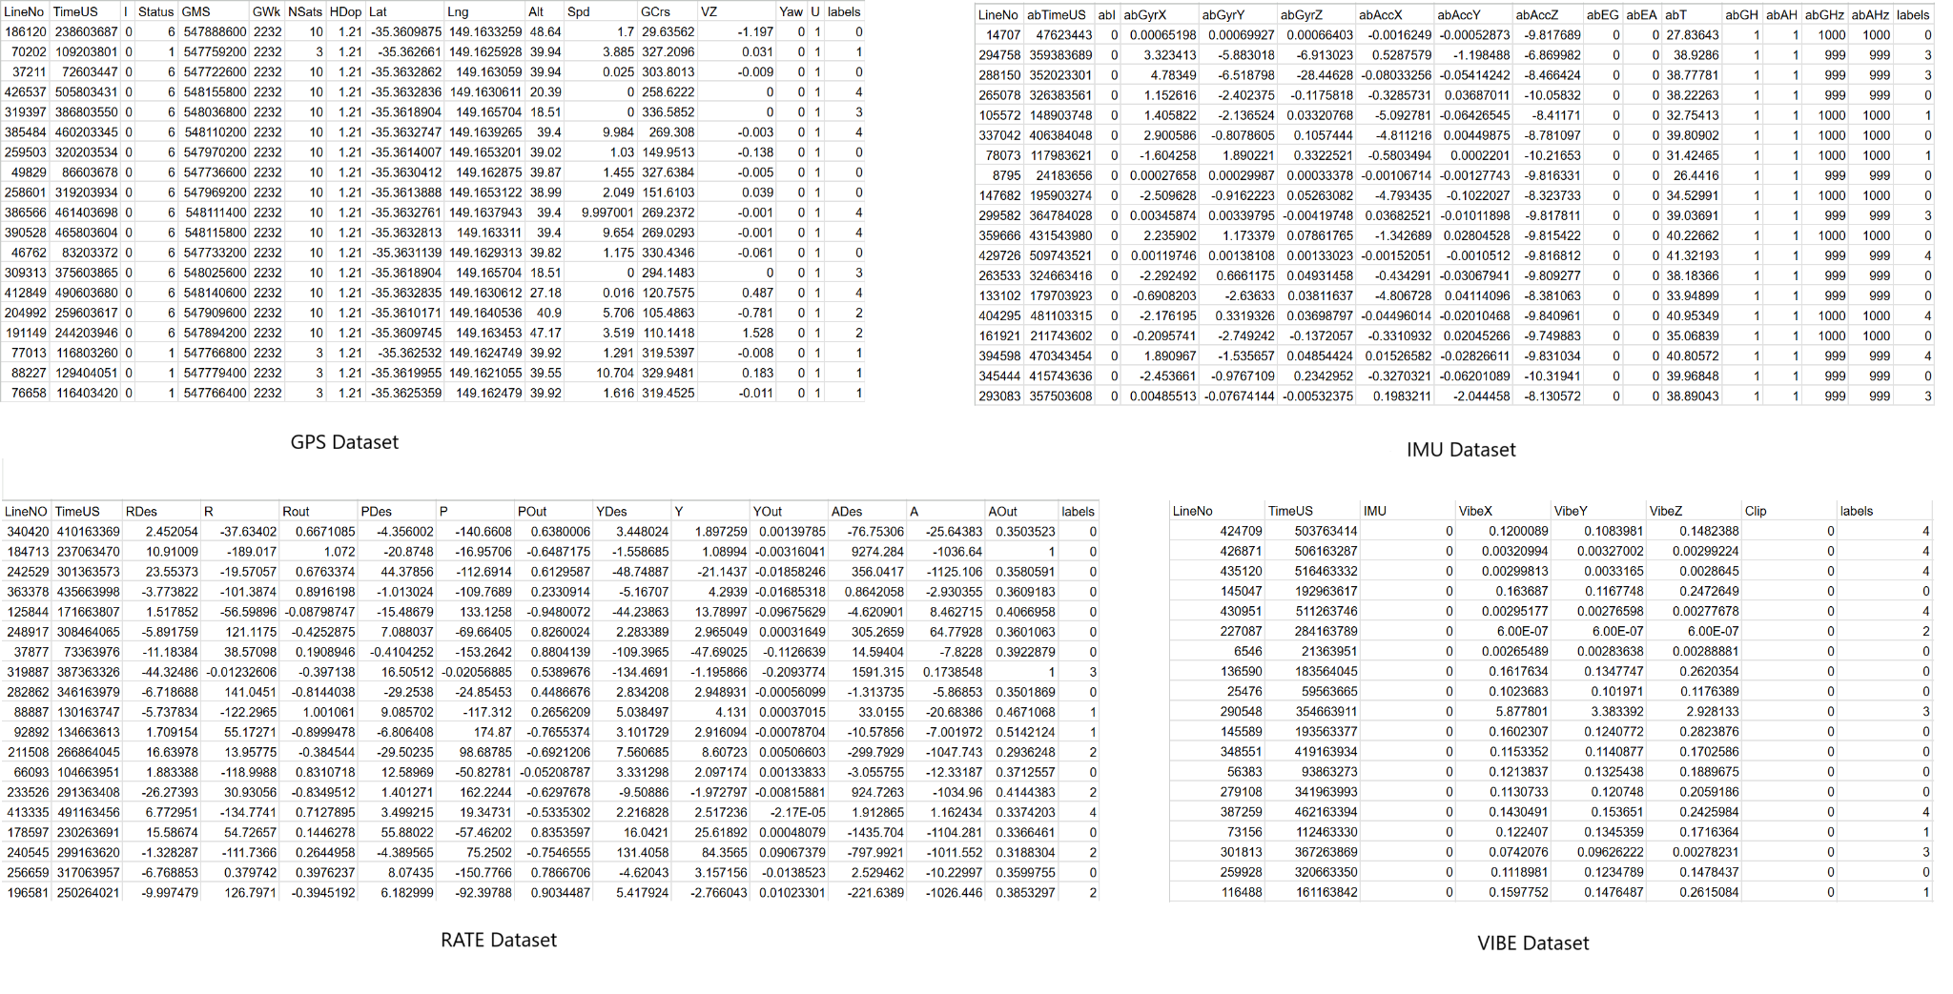
TLM:UAV Anomaly Detection Datasets

Slide 9
Dataset : Labels
Label 0: Normal UAV State - Indicates that the UAV is operating within expected parameters without any anomalies.
Label 1: GPS Anomaly - Signifies a malfunction or error in the GPS system, leading to incorrect positioning.
Label 2: Accelerometer Anomaly - Indicates a fault or abnormal reading in the accelerometer, affecting motion detection.
Label 3: Engine Anomaly - Represents a failure or irregularity in the UAVs engine, potentially compromising flight performance.
Label 4: RC Anomaly - Signifies a problem with the remote control system, impacting communication and control of the UAV
Notes:
Label
Label 0: Normal UAV State - Indicates that the UAV is operating within expected parameters without any anomalies.
Label 1: GPS Anomaly - Signifies a malfunction or error in the GPS system, leading to incorrect positioning.
Label 2: Accelerometer Anomaly - Indicates a fault or abnormal reading in the accelerometer, affecting motion detection.
Label 3: Engine Anomaly - Represents a failure or irregularity in the UAV's engine, potentially compromising flight performance.
Label 4: RC Anomaly - Signifies a problem with the remote control system, impacting communication and control of the UAV.

Slide 10
Dataset : Features
timestamp: exact time at which the data point was collected
DesRoll: indicates the intended orientation around the longitudinal axis.
Roll: indicates its current orientation around the longitudinal axis.
DesPitch: indicates the intended orientation around the lateral axis of the UAV.
Pitch: represents current orientation around the lateral axis.
DesYaw: denotes the intended orientation around the vertical axis.
Yaw: indicates current orientation around the vertical axis.
ErrRP: indicates the difference between desired and actual orientations.
ErrYaw: represents the deviation from the desired orientation.
MagX, MagY, MagZ: helps assess the UAVs orientation and position.
abGyrX, abGyrY, abGyrZ: indicates the UAVs rotational movement.
abAccX, abAccY, abAccZ: provides insights into the UAVs linear movement and forces acting on it.
Notes:
Dataset
timestamp: Records the exact time at which the data point was collected, providing temporal context for the UAV's state.
DesRoll: Represents the desired roll angle of the UAV, indicating the intended orientation around the longitudinal axis.
Roll: Shows the actual roll angle of the UAV, reflecting its current orientation around the longitudinal axis.
DesPitch: Indicates the desired pitch angle, which is the intended orientation around the lateral axis of the UAV.
Pitch: Displays the actual pitch angle of the UAV, representing its current orientation around the lateral axis.
DesYaw: Specifies the desired yaw angle, which denotes the intended orientation around the vertical axis.
Yaw: Represents the actual yaw angle of the UAV, indicating its current orientation around the vertical axis.
ErrRP: Measures the error in roll and pitch angles, indicating the difference between desired and actual orientations.
ErrYaw: Indicates the error in the yaw angle, representing the deviation from the desired orientation.
MagX, MagY, MagZ: Capture the magnetic field readings along the X, Y, and Z axes, which help assess the UAV's orientation and position.
abGyrX, abGyrY, abGyrZ: Represent the angular velocities around the X, Y, and Z axes, indicating the UAV's rotational movement.
abAccX, abAccY, abAccZ: Record the acceleration along the X, Y, and Z axes, providing insights into the UAV's linear movement and forces acting on it.

Slide 11
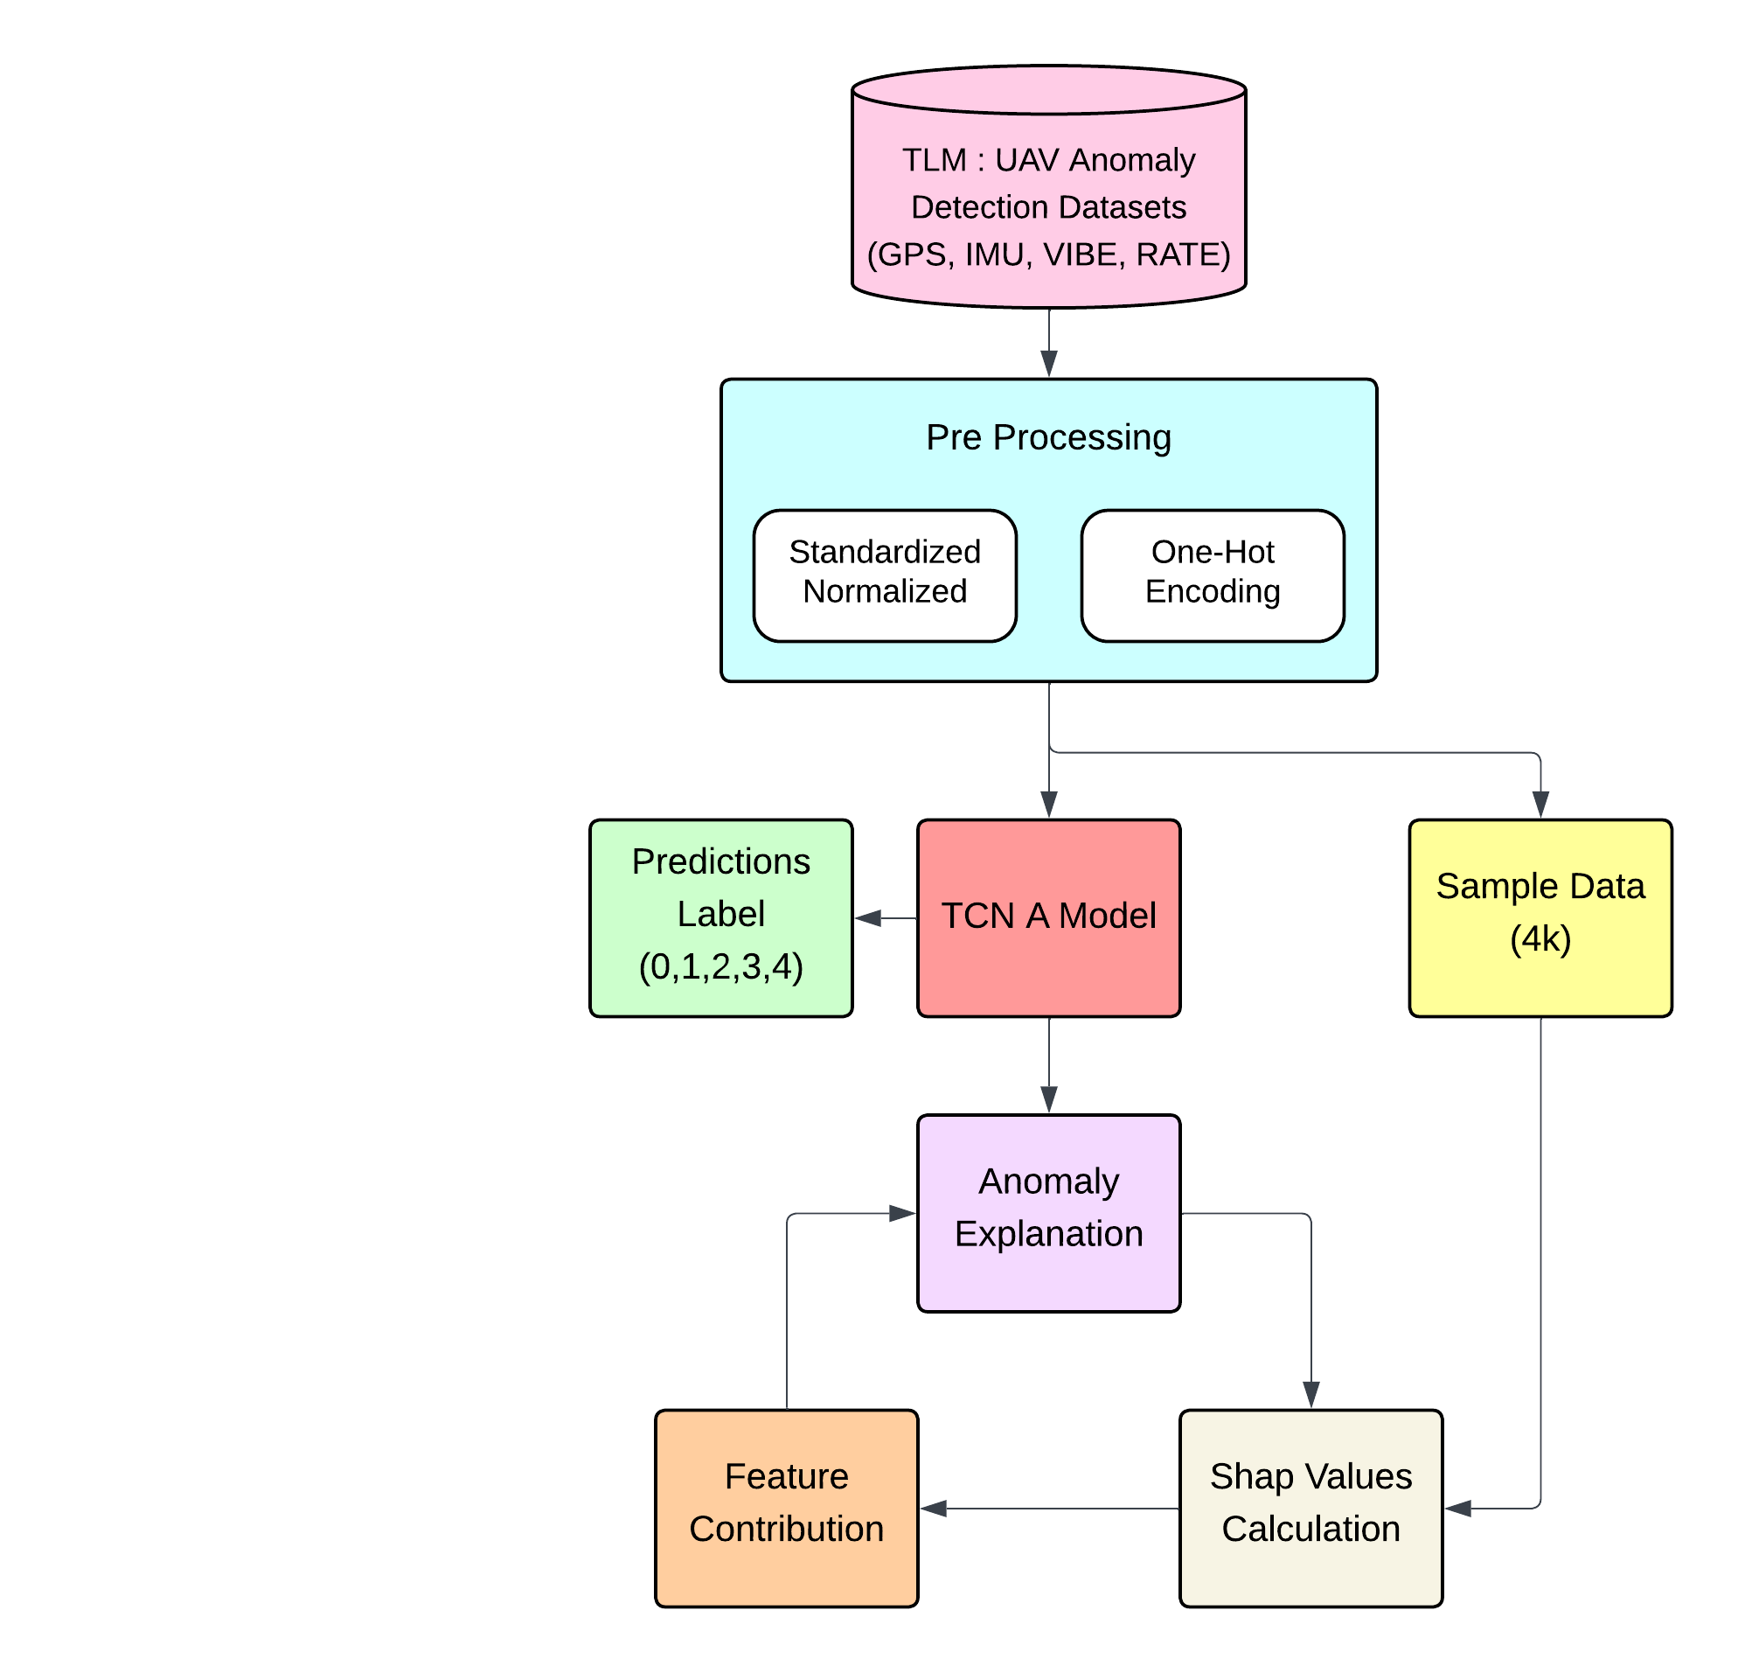
System Block Diagram

Slide 12
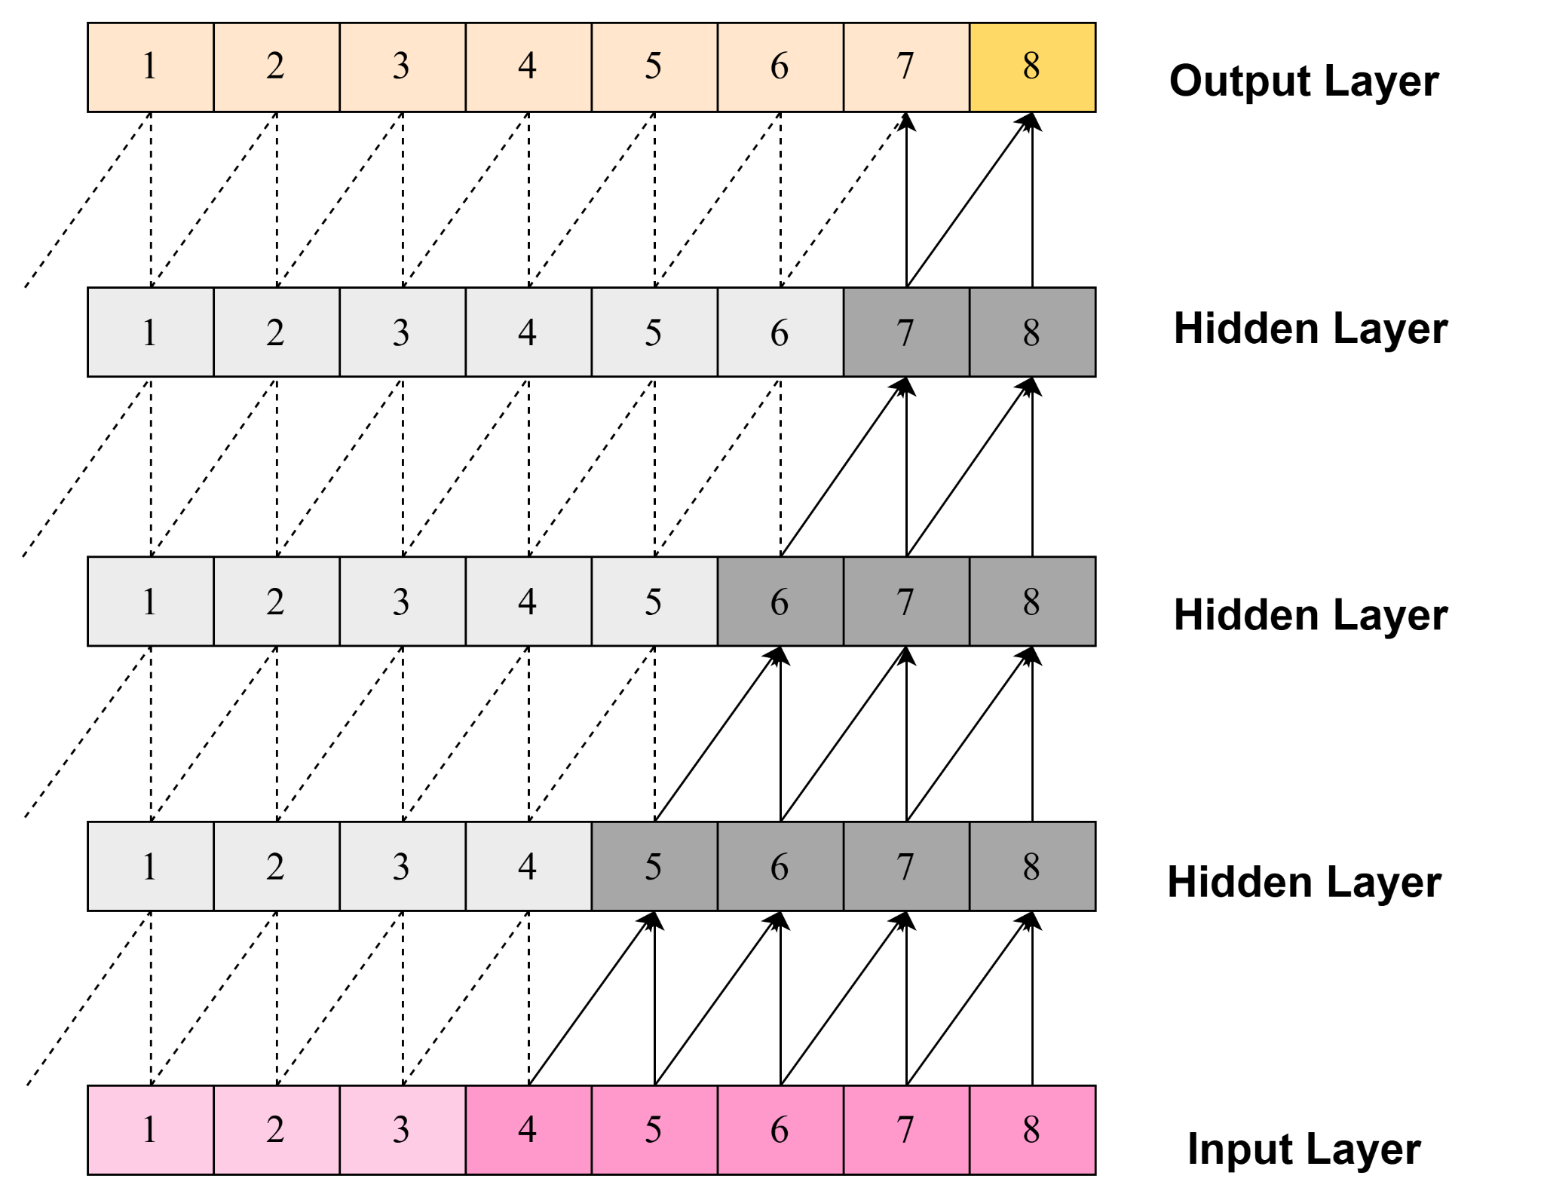
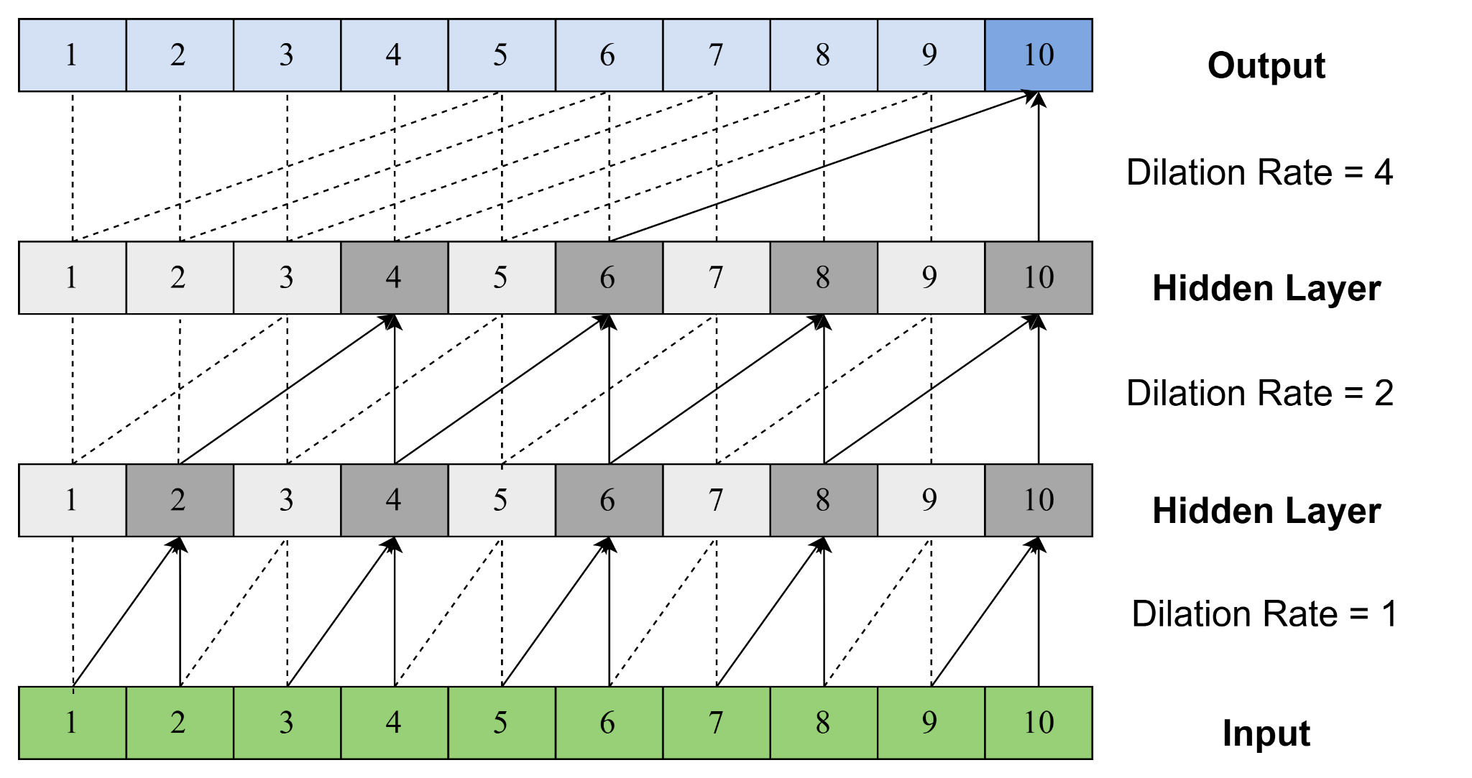
Causal Convolutional Layers with and without Dilation.

Slide 13
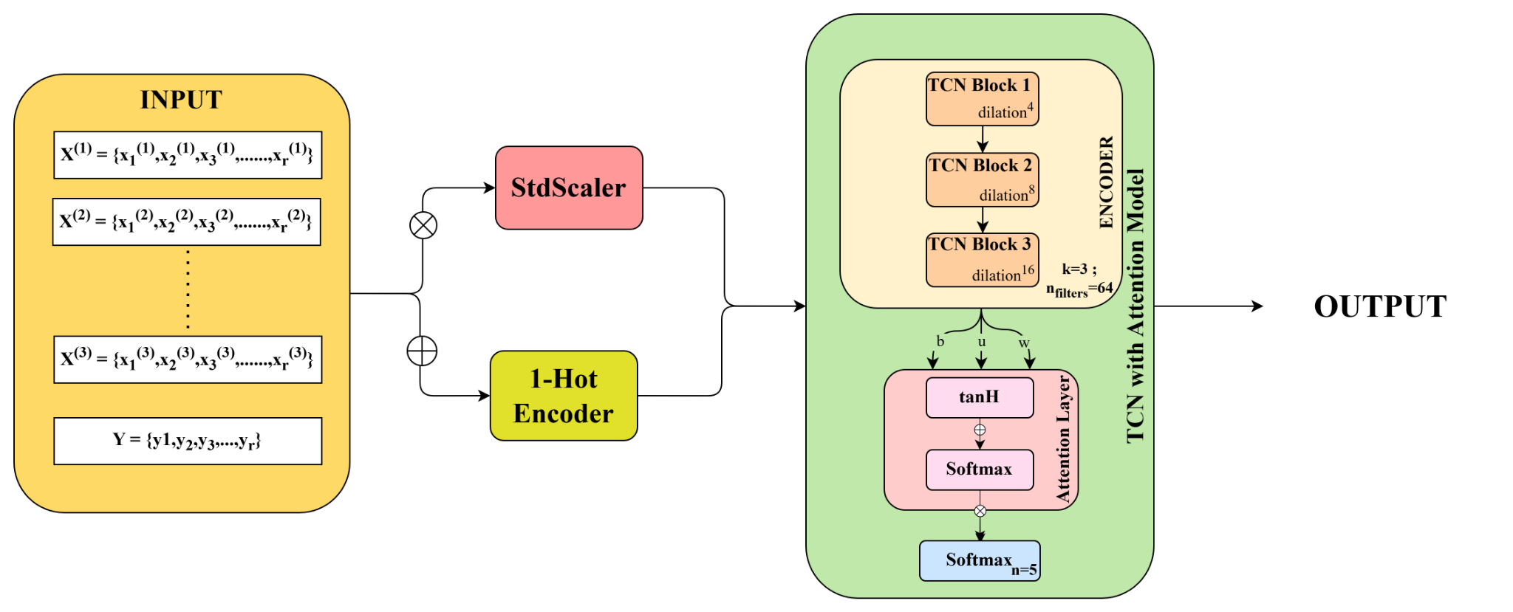
Model : TCN with Attention

Slide 14
Result Analysis Table
 |  | GPS Data |  |  | IMU Data |  |  | RATE Data |  |  | VIBE Data
Model | Label | F1 Score | Accuracy | Recall | F1 Score | Accuracy | Recall | F1 Score | Accuracy | Recall | F1 Score | Accuracy | Recall
CNN | Normal | 0.8881 | 0.8846 | 0.8916 | 0.7552 | 0.7325 | 0.7793 | 0.7506 | 0.7186 | 0.7854 | 0.7158 | 0.6010 | 0.8849
 | GPS | 0.9587 | 0.9632 | 0.9544 | 0.6271 | 0.7551 | 0.5363 | 0.6459 | 0.7560 | 0.5639 | 0.4796 | 0.6666 | 0.3746
 | Acc | 0.8436 | 0.8792 | 0.8108 | 0.8360 | 0.8364 | 0.8355 | 0.8240 | 0.8687 | 0.7837 | 0.0000 | 0.0000 | 0.0000
 | Engine | 0.6269 | 0.6802 | 0.5813 | 0.6790 | 0.5516 | 0.8829 | 0.9182 | 0.9207 | 0.9157 | 0.8919 | 0.9512 | 0.8395
 | RC | 0.7939 | 0.7470 | 0.8471 | 0.6510 | 0.7395 | 0.5814 | 0.6959 | 0.6761 | 0.7169 | 0.3177 | 0.5622 | 0.2214
TCN-A | Normal | 0.9840 | 0.9847 | 0.9828 | 0.9526 | 0.9649 | 0.9516 | 0.9483 | 0.9635 | 0.9291 | 0.7515 | 0.9133 | 0.9407
 | GPS | 0.9868 | 0.9872 | 1.0000 | 0.9870 | 0.9787 | 0.9870 | 0.9117 | 0.9682 | 1.0000 | 0.8241 | 0.8410 | 0.8599
 | Acc | 0.9787 | 0.9789 | 0.9718 | 0.9347 | 0.9490 | 0.9437 | 0.9744 | 0.9677 | 0.9611 | 0.0000 | 0.2119 | 0.0000
 | Engine | 0.9790 | 0.9707 | 0.9722 | 0.9825 | 0.9516 | 0.9825 | 0.9697 | 0.9498 | 0.9536 | 0.2952 | 0.2243 | 0.1732
 | RC | 0.9962 | 0.9915 | 0.9924 | 0.9451 | 0.9736 | 0.9451 | 0.9835 | 0.9869 | 0.9746 | 0.9474 | 0.5816 | 0.9032

Slide 15
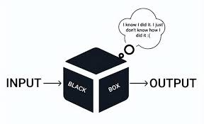
Explainable Artificial Intelligence(XAI)
Explainable AI (XAI) refers to techniques and methods that help humans understand and interpret the predictions made by machine learning models. As AI systems become increasingly complex, understanding how they arrive at decisions is crucial for trust, accountability, and fairness.
The primary goal of XAI is to shed light on the "black box" nature of many complex AI models, particularly deep learning, by providing insights into how they arrive at their decisions.
Why Do We Need XAI?
Trust and Transparency
User Adoption
Bias and Fairness
Debugging and Model Improvement
Notes:
Why Do We Need XAI?
Trust and Transparency
Black-box AI models often make decisions that are difficult to interpret.
XAI helps in making AI systems more understandable to users, increasing trust.
Regulatory Compliance
Many industries, such as finance and healthcare, have regulations requiring explainability (e.g., GDPR’s "Right to Explanation").
Bias and Fairness
AI models may develop biases due to training data.
XAI techniques help identify and mitigate biases in predictions.
Debugging and Model Improvement
Developers can analyze misclassifications and refine the model using XAI.
Helps in feature selection and optimizing model performance.
User Adoption
When users understand AI predictions, they are more likely to adopt AI-driven solutions in decision-making.

Slide 16
SHapely Additive exPlainations(SHaP)
SHAP ,it is a Model Agnostic Method of XAI, uses game theory to assign each feature an importance value (Shapely Values) for a particular prediction, considering its contribution across all possible feature combinations.
It provides both local and global explanations.
The contribution can be positive (pushing the prediction higher) or negative (pushing it lower).
There are various types of SHaP explainer which can be implemented according to model on which it has to be implement:
Kernel Explainer
It can be applied to any model but is generally slower than model-specific explainers, especially for complex models or large datasets, as it requires multiple model evaluations.
Notes:
Why Do We Need XAI?
Trust and Transparency
Black-box AI models often make decisions that are difficult to interpret.
XAI helps in making AI systems more understandable to users, increasing trust.
Regulatory Compliance
Many industries, such as finance and healthcare, have regulations requiring explainability (e.g., GDPR’s "Right to Explanation").
Bias and Fairness
AI models may develop biases due to training data.
XAI techniques help identify and mitigate biases in predictions.
Debugging and Model Improvement
Developers can analyze misclassifications and refine the model using XAI.
Helps in feature selection and optimizing model performance.
User Adoption
When users understand AI predictions, they are more likely to adopt AI-driven solutions in decision-making.

Slide 17
Most Contributing Features for Anomalies
 | GPS | IMU | RATE | VIBE
GPS Anomaly | GMS | abT | RDes | VibeZ
Accelerometer Anomaly | Yaw | abEG | YOut | IMU
Engine Anomaly | U | abAHz | Rout | Clip
RC Anomaly | GCrs | abAH | YDes | VibeY

Slide 18
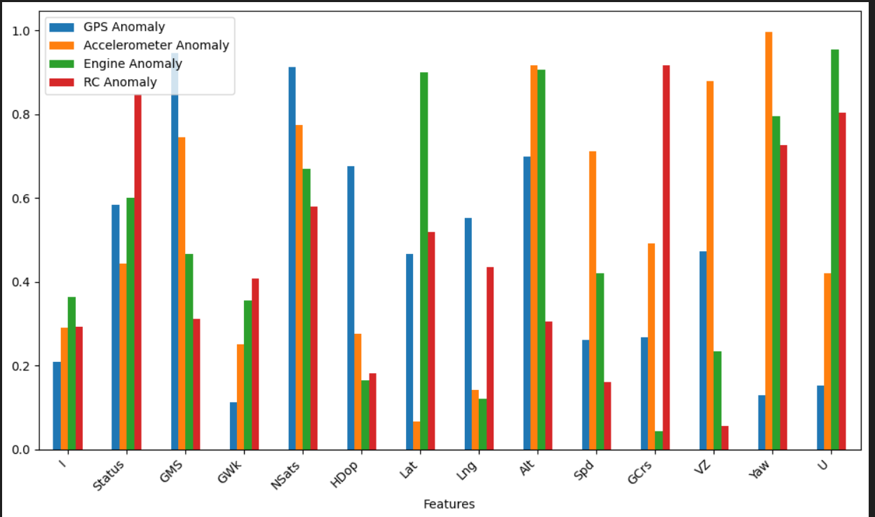
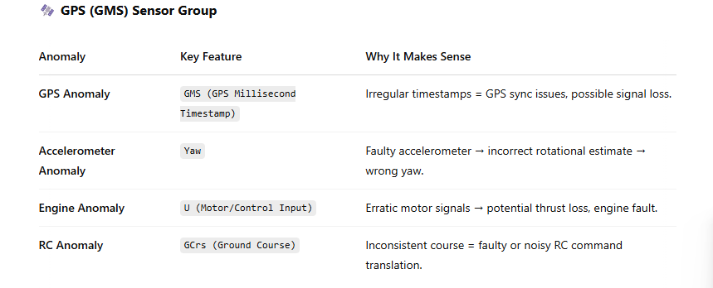
SHapely Additive exPlanation (SHAP)
For GPS Dataset
Notes:
Temp impacts GPS signal timing → location error.
Distorted gravity = flawed motion estimation.
Unstable RPMs = hint toward engine dysfunction.
Control loop instability = signal quality or latency from RC.

Slide 19
SHapely Additive exPlanation (SHAP)
For GPS Dataset
Notes:
Temp impacts GPS signal timing → location error.
Distorted gravity = flawed motion estimation.
Unstable RPMs = hint toward engine dysfunction.
Control loop instability = signal quality or latency from RC.

Slide 20
References
https://www.linkedin.com/pulse/revolutionizing-communication-information-vital-role-unmanned-lateef-enjcf/
https://www.kaggle.com/datasets/luyucwnu/tlmuav-anomaly-detection-datasets/data
https://www.mdpi.com/2076-3417/13/7/4301
https://drive.google.com/file/d/1pk9uazK7PoUViKdxOR4kwxz6WEAVefmS/view?usp=drive_link
https://xai-tutorials.readthedocs.io/en/latest/_model_agnostic_xai/shap.html

Slide 21
Thank You!

Slide 22
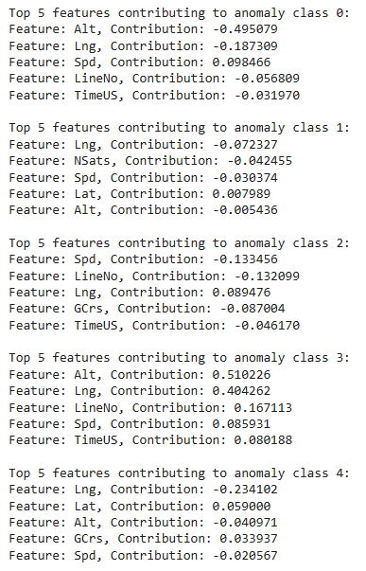
SHapely Additive exPlanation (SHAP)
For GPS Dataset

Slide 23
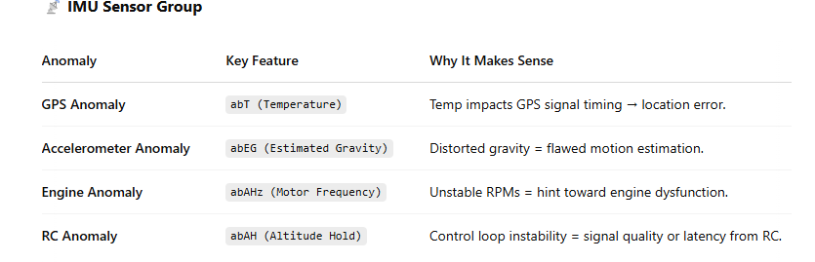
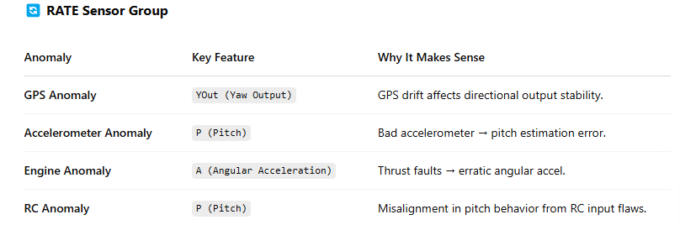

Slide 25
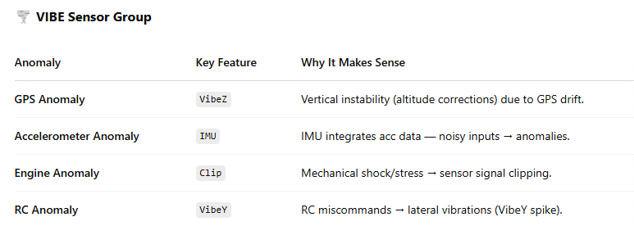

Slide 26
Future Work
Explainable AI (XAI) is a field of artificial intelligence that focuses on making AI models' decisions and actions understandable to humans. In essence, it aims to open the "black box" of complex AI algorithms, particularly those used in deep learning, to provide transparency and clarity.
The Need for XAI:
Trust and Transparency
Ethical Concerns
Regulatory Compliance
Debugging and Improvement
Among the prominent XAI techniques are
SHAP (SHapley Additive exPlanations)
SHAP, rooted in game theory, calculates the contribution of each feature to a prediction, providing both local and global interpretability. It leverages Shapley values to ensure fair distribution of feature importance. SHAP has different type of "explainers" that are optimized for different types of models.
LIME (Local Interpretable Model-agnostic Explanations)
Notes:
Testing this model on other UAV datasets
Apply the improved TCN-AE model on different datasets to evaluate its generalization capability and performance across various UAV scenarios.
One of them is Korea Aerospace Research Institute, and another is Vireo Flight7(by University of Minnesota Flight Laboratory) we have requested them to make the dataset available to us.

